Slide 1






Trainee Case Studies

Slide 2
Objectives: Vikalp Voucher Program
Demonstrate the benefits of using the Voucher model in skill development - as compared to existing models of intervention for skill development / funding of skill development programs.
Offer students the right to choose from skill development programs based on their aptitude and not on availability of schemes, courses (ownership on students’ part : choice of course + Co-pay).
Demonstrate the benefits of joint ownership of the skill development process by Government, semi government, civil society, funding agency and Training providers.
Develop a detailed Implementation Toolkit which will serve as a How to guide for scaling & replicating this model elsewhere in the country.

Slide 3
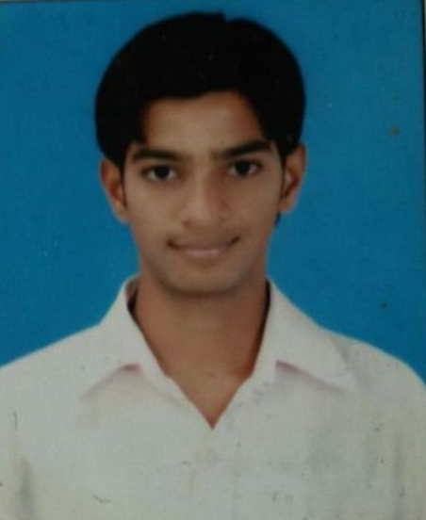

Santosh Sadafale
Travel & Tourism at IIFLY (Phase 1)
Skill-based support of Vikalp has steered Santosh
into the new realm of travel & tourism
23-year-old Santosh Sadafale has just started working in reputed travel firm J R Technologies following the training at IIFLY. He is now part of the US process that provides customer service in ticketing.
A few months ago, Santosh was struggling to find a new opportunity and didn’t know where to start. Hailing from a family with limited financial means, Santosh had to give up studies post Class XII. He has since worked with eBay in mail process to support his family. However, such a job was not the one he envisioned doing in the long run.
Santosh had been eyeing the travel and tourism sector for some time and was excited to hear about the BARTI sponsored Vikalp program. His friend Mahesh, who had also undergone a course under BARTI, recommended that he join IIFLY, which offered a diploma in travel and tourism. With the help of our Vikalp Voucher, the huge fee was no longer a concern. Under the copayment option, Santosh paid merely 10% of the fees to enrol for the diploma by IIFLY.
IIFLY worked closely with Santosh to help him prepare to enter the sector. Completing the diploma boosted Santosh's confidence and gave him a chance to show that he was able to meet the responsibilities and had the knowledge that is required for the industry. Training unemployability skills such as interview techniques have worked to improve his communication and language competencies.
IIFLY also supported Santosh through the placement process. The guidance he received at IIFLY helped him crack the interview and land a trainee position at J R Technologies. Santosh is very happy with his new job and wants to be part of the company for next five years.
“I am working towards a manager’s position”, he claims.

Slide 4
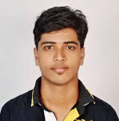
Prashant Jadhav
IT course at Edulight (Phase 1)
An engineer got the boost he needed to get his first job, thanks to employment oriented skill support of the Vikalp .
Prashant, a Panvel resident, doesn’t mind the hectic daily travel for work in Kandivali. After all, he is doing the job he always wanted. Things have worked out well for him. He was placed in Mahindra as a Desktop Engineer following his training at Edulight – a situation that, a few months ago, seemed a distant dream. With little practical experience, Prashant was not very confident about his future. A B.E. in Electronics did not guarantee a job. His degree had simply equipped him with theoretical knowledge, and hitting the job market, he realised he needed more.
The timely support of Vikalp provided the platform Prashant was looking for. The option to pursue a course of his choice offered him new chance in the IT sector. With the help of the skill voucher, he could pay as little as 10% of fees to enrol in the IT & Hardware course at Edulight.
The practical training he received in the course has helped him perform in his current role. While practical training prepared him to tackle challenges in the field, special sessions on soft skills and mock interviews gave him the extra boost he needed to perform as a professional.
“College training along with practical training at Edulight has made me confident”, he says.Now working with Mahindra, he is earning around INR 9,000 per month. “My goal is to improve my career growth and spend a career in a good organisation”, he says.

Slide 5
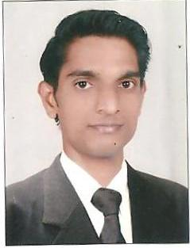
Rahul Chintaman Sonare
Stock Markets, Financial Planning Academy (FPA) (Phase 1.1)
A financial sector aspirant is one step closer to his goals thanks to the skill-based support of Vikalp .
College life inspires the best in everybody. For Rahul, a B.M S Degree in Finance was to open the door of opportunities and a better life. However, in spite of his best efforts, the right jobs always seemed beyond his reach. With limited job skills, he was not able to move forward.
Things are looking much brighter for him since he enrolled in the Vikalp Program. The voucher program, which focuses on job employment, allowed Rahul to enrol in a course of his choice with fee requirement as low as 10% of total course fees. “There is no organisation which focuses on employment with almost no fees. It’s a rare program”, he says.
Rahul was impressed by the help he received from FPA. Students are encouraged to improve their communication skills. The focused, small batches have helped stimulate class room discussions. His English and communication have improved, increasing his overall confidence.
“Before taking up admission in course I was not aware of software of stock markets and other concepts. Now I am confident that I know everything there is to know about stock markets!”, he says. The personal change has improved his outlook towards the future. “I have the knowledge now so I don’t think I’ll face any more difficulties”, He says. When asked about his future goals, he replies, “In next few years, I would like to have an important role in a reputed brokerage such as Sharekhan, Reliance Money and Motilal Oswal”.
With the help of FPA, Rahul is now closer to his goals. Post training, he was placed with reputed broking firm, BMA Wealth Creators. As a Relationship Manager-Dealer, Rahul now earns a monthly salary of INR 10,000.

Slide 6
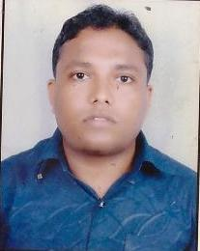
Chetan Kamble
Four-Wheeler at Don Bosco (Phase 1)
25-year-old Chetan is hopeful that his training under Vikalp will open doors of opportunities for good jobs.
Chetan knew that his upcoming interview with Mahindra would turn out well. After all, his training at Don Bosco had been an informative experience. Chetan is not a fresher. Post graduation, he was engaged only in desk jobs. Until his training at Don Bosco under Vikalp, he was doing data entry for Asha Private Limited earning a monthly salary of INR 9,000. His earlier job at Mahindra had, however, invoked his interest in the automobile industry. “My job in Mahindra was front desk and will not count in experience. This is the reason I joined this course”, he explains.
Chetan came across Vikalp program through a career mela announcement in Maharashtra Times. He had very little expectation from the program. “I thought since this is a Government program, there will be a small seminar to motivate students. But when I attended, I really liked it.”
The four-wheeler course was not Chetan’s first choice. With the variety of course options, Chetan was confused between the four-wheeler and the Auto CAD/CNC courses. Learning about his interest in auto parts servicing industry, counsellors steered him towards the four-wheeler mechanic course at Don Bosco. As an SC candidate, Chetan was offered the voucher, whereby students had to pay 10% of the fees and the remaining would be paid by Vikalp. “Outside
I would have to pay INR 25,000 for a diploma”, he says.
At Don Bosco, Chetan has received theoretical and practical training. The practicals were particularly helpful to him. As a fresher in automotive industry, Chetan didn’t mind starting from scratch. He now works with Mahindra as a trainee in their service workshop, and is optimistic about the future. He is confident that this experience will lay the foundation of his career in the industry. He currently earns INR 3,500 a month and will be instated as a permanent employee after six months.
When asked about his future, he says “I would like to work towards a position of Workshop Manager in next 3 years”

Slide 7
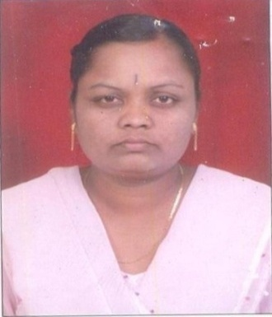
Suvarna Gajare
Bedside Assistant at Pratham (Phase 1.1)
A timely opportunity has made 35-year-old Suvarna confidently approach a career in the field of nursing.
.
Suvarna’s financial situation is difficult. Her husband, a taxi driver works only 15 days a month and has a drinking problem. Their monthly income does not exceed INR 3,000. There is not much support from other family members. Suvarna took up sewing to help make ends meet. For a year, she struggled to find work. With her small source of income, training costs being INR 10,000 she was promised jobs in airport cleaning and housekeeping post training. “Why should I study and then do such work?”, she asks. With the help of Vikalp Program, however, training fees was no longer a hurdle. With the voucher, Suvarna paid only INR 1000 to enrol under BSA course offered by Pratham. “This program caters to only SC groups. No one else gives such a chance, or scholarships”, she says.
The Bedside Assistant course was not the only option open to Suvarna. Vikalp enables students to redeem their voucher at any of the institutes empanelled with the program. At the Vidyavihar Seminar, courses in Banking and Accounting too had caught her interest. Suvarna had previously completed a course in Tally and was interested in using her computer skills to continue in the field. However, her friend recommended Pratham, and its proximity to her residence tilted scales in favour of the nursing program.
The four-month program at Pratham ensures her both theoretical and practical training. “I found lessons on description of anatomy and its functions most helpful”, she says. Today, half way into the course, she has started with the practical training at Lifeline Hospital and is using her classroom training well. As a student, she does not like to talk much about her job expectations and wants to first gain experience.. She is however cautious. “I would not like to do cleaning at hospitals”, she clarifies.
Suvarna doesn’t want to study further. She just wants to start with a job as soon as possible. With skill-based training from Pratham, she feels a job is assured and is grateful for the opportunity Vikalp has given her. “I have recommended the benefits of the course to at least 20 people!”, she says.

Slide 8
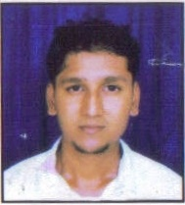
Rajeev Tambe
Logistics Course at Trade Wings (Phase 1.1)
The Vikalp Voucher Program has improved the job prospects of college dropout by offering him skill-based support
A college degree is an important gateway to employment, a career and a better future. For young Rajeev, dropping out of BMS just added to his woes.
Long term education was not an option for Rajeev. With his father due to retire from BPT in two years and a sister still pursuing her education, the pressure on him has only just begun. Without job-oriented skills or a graduate degree, the scope of him landing a good job thus remained limited.
When Rajeev came across the BARTI-Vikalp program. This skill development partnership program offered Rajeev the opportunity to access quality training in a sector of his choice without paying exorbitant fees. “Without Vikalp sponsorship, the logistics course would have cost me INR 30,000 to 40,000. Here, I just had to pay INR 2,500”, he says.
Rajeev was aware about IATA and was delighted that Trade Wings offered such a course under the voucher scheme. Today, half way into the course, he has gained knowledge and confidence. Besides industry training, compulsory classroom interactions have improved his language and communication skills.
The training and support has encouraged his ambition. He is hopeful to start his career as a Custom House Agent. Smiling, he says “I hope I can soon earn INR 30,000 per month to help me survive in Mumbai”.
His goal, he states, is to work with companies such as Maersk Line within the next five years.

Slide 9
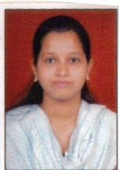
Prajakta Katare
Student at Trade Wings Institute (Phase 1.1)
After a year of unemployment, Prajakta finally found an opportunity that has encouraged her to confidently approach a career in travel & tourism sector.
Prajakta’s story is quite similar to many other young Indians who struggle in the job market because they lack the skills. After completing her graduation in 2008, Prajakta enrolled for a post graduation program in Travel and Tourism Management at Garware Institute. Her family’s financial crisis forced her to drop out of the course. With little training, and poor command over English, decent jobs were out of reach. For more than a year, Prajakta struggled. Staying at home and receiving job rejections weighed badly on her morale. However, things took a turn for the better when she saw an advertisement in a local newspaper about the BARTI seminar, which she attended and was subsequently selected for the Vikalp program.
The Vikalp Voucher scheme has helped Prajakta in two ways. With the help of voucher co-payment, Prajakta could undertake training without worrying about fees. Secondly, the program offered her an opportunity to undertake training in a sector she had earlier missed out on. She explains, “I really liked Voucher system of step by step payments. It is encouraging to know that someone is supporting us to undertake the training”.
At Trade Wings, she started from scratch, learning about new areas such as booking and ticketing. She is confident that this training has enhanced her prospects in securing a decent job.
Prajakta now looks to the future with optimism. She has no reservations. She wants all the professional experience can get in the sector. She hopes that one day she would be able to run her own travel agency!

Slide 10
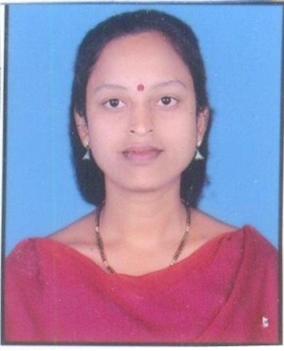
Reshma Bhosale
Bedside Assistant Course at Pratham (Phase 1.1)
Reshma Bhosale is on her way to becoming a successful nurse with the support of the Vikalp.
33-year-old Reshma views a job as the window to solve her problems – a means to provide a better life for her two children, and financial support for her husband, who is currently the sole breadwinner of the family. Reshma is undergoing practical training at the Das Hospital and will soon be ready to take up a job in Home Care or Hospitals. She acknowledges the role that the BARTI- Vikalp program has played in improving her prospects.
Under Vikalp, Reshma was offered an opportunity to undertake the Bedside Assistant course at Pratham paying as little as INR 1,000, 10% of the total fees. She says, “If I get good marks in the exam, they will refund this amount too.”
Reshma first came across the program during a visit to Pratham for a job. At the career mela, a range of course options invoked her interest. and the Bedside Assistant course offered Reshma a wonderful opportunity. Reshma had been interested in nursing work before. With this course, she could do the work she always wanted.
At Pratham, trainers worked closely with her to make her aware on the different elements of nursing. The training at Pratham was split into classroom and practical training. Theoretical sessions on hygiene, anatomy prepared her for stint at Das Hospital. Daily English speaking classes and computer training has improved her confidence.
Reshma’s experience at Das Hospital has reinforced her belief that nursing is the right career. “Two patients have told me that I would be a good nurse!”, she says.

Slide 11
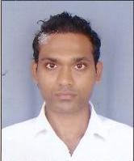
Harish Bhadrige
Four-Wheeler at Don Bosco (Phase 1)
Vikalp has offered 29-year-old Harish a second chance in the automotive industry.
As Harish awaits his first job interview, he hopes to finally get the opportunity he has been looking for quite some time now. Starting young in the automotive industry did not pay off for him. Post Class XII, a job at Imperial Motors paid poorly. An apprenticeship role as a trainer at Mahindra was shortlived following a hand injury. After a three-year break after graduation, returning to the same job market was hard. Reluctantly he had to accept a job in a hospital to support himself financially.
Vikalp, the skill development program sponsored by BARTI has now offered him a second chance. Harish had come across the advertisement by BARTI for the career mela in a Marathi Newspaper. At the seminar, students were presented with vast range of course options across many sectors. However, with an interest in spare parts, the four-wheeler course by Don Bosco seemed the best option.
The program, which caters to SC students, offered Harish a voucher, which later was to be redeemed at any of the institutes empanelled under Vikalp. This voucher scheme enabled Harish to undertake the course of his choice paying 10% of the actual course fees. “I didn’t have that much capacity to pay for the course without discount”, he says. Before joining Don Bosco, Harish had been looking up for such institutes in Mumbai and Nagpada. “Even a one-year course of automobile costs INR one to one and a half lakh”, he says.
For Harish, his experience and the training from Don Bosco are the only things he can rely on for a future in the industry. “When the vehicle arrives in store, we are expected to do everything. Companies do not teach anything,” he says. The six-month course at Don Bosco offered him both theory and technical knowledge including mechanics.
Harish now only expects a little help with placement. With help from Don Bosco, he hopes to re-enter the industry as store room technician or a four-wheeler trainer. Harish belongs to a hard working family. With a good job, he hopes that he too can soon contribute to the family.

